Slide 1

DiagCaptor Introduction
PCEBG
Server Design Center - SW
2008.11.28

Slide 2
Agenda
Overview
Software Architecture
Test Coverage
User Interface
Command Line Interface (CLI)
Manufacturing Test Flow

Slide 3
Overview
FCDP for Linux Project
  Foxconn Common Diagnostic Platform for Linux
  Consist of a set of diagnostic Linux tools
  Function test for Server, M/B, Notebook
  Main program: DiagCaptor
Purpose
  Diagnose UUT (In lab / Manufacturing)
  Automatic manufacturing process
Three test mode
  Normal Test
  PowerOn Test
  BurnIn Test

Slide 4
Overview
Environment Support
    FC9 or later
    Red Hat AS5 or later
    SuSE 9.2 or later
Develop tools
    gcc/g++
    QT4.4.0
    GNU make
    Subversion
32bit and 64bit OS support

Slide 5
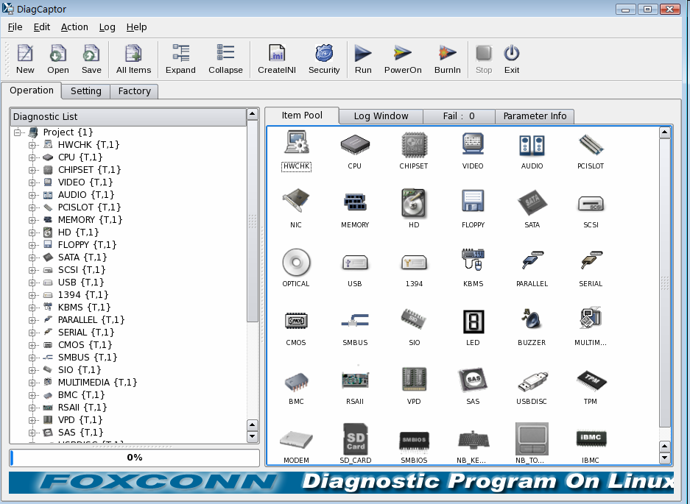
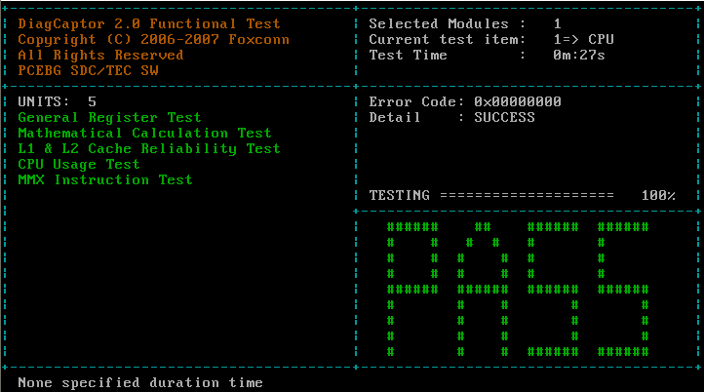
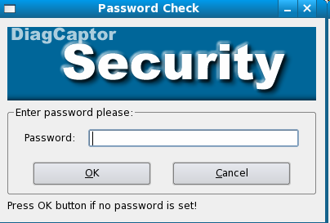
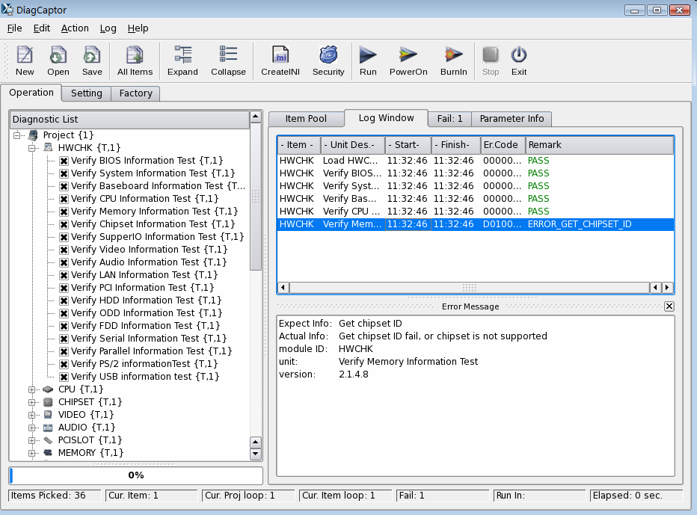
three advantage
1
In time, Professional, Local
2
Technology easy to design, deploy and maintain
3
Custom development for customer

Slide 6





Roadmap
DiagCaptor
V 2.3.0
QT4.5 GUI
40 modules,241 test unit
FC10,Red Hat AS6, SuSe 10
Kernel 2.6
32bit,64bit
XML, Server Optimize
DiagCaptor
V 2.2.0
QT4.4 GUI
32 modules,220 test unit
FC9,Red Hat AS 5
Kernel 2.6
32bit,64bit
Cappy, CLI
DiagCaptor
V 2.0.0
QT4 GUI
27 modules,135 test unit
FC8,Red Hat AS 4 ,SuSE9.2
Kernel 2.6
32bit
Normal, PowerOn, BurnIn
DiagCaptor
V 1.0.0
QT3 GUI
36 modules
FC3,Red Hat AS 3
Kernel 2.6
32bit
FoxDiag V2.0
DiagCaptor
V 0.1.0
FoxDiag V1.0
GUI
CPU, memory
FC 3
Kernel 2.4
Cappy V1.0
2005
2006
2007
2008
2009
2010

Slide 7
2009 DiagCaptor
Project
DiagCaptor
Phase III
Phase IV
Support More device
Multi-Core CPU
Optimize the flaw of testing
Support More
Linux Distribution
test OS customize
Optimize the core of testing
Capability
64bit OS Optimize
Red Hat AS6, SuSE 11,Ubuntu 8
IBMC/BMC
EFI/UEFI
Q4/08
Q1/09
Q2/09
Q3/09
Q4/09
2009
2010

Slide 8
Software Architecture
User Interface and Configuration
CLI
Graphic Library (Qt4.4.0)
Diagnostics Module (Share Library)
System Library
Common Library
Linux OS
Device driver
Hardware Platform

Slide 9
Test Coverage
1 | HWCHK | 2 | Memory | 3 | PCI Slot | 4 | RSAII
5 | CMOS | 6 | Optical Device | 7 | Hard Drive | 8 | SIO
9 | CPU | 10 | Parallel Port | 11 | 1394 | 12 | LED
13 | ChipSet | 14 | PS2 KB&MS | 15 | USB | 16 | Audio
17 | SMBus | 18 | SCSI | 19 | Buzzer | 20 | Video
21 | TPM | 22 | IBM- VPD | 23 | Serial Port | 24 | Multimedia
25 | USB-DISC | 26 | BMC | 27 | Floppy | 28 | SAS
29 | SMBIO | 30 | NIC | 31 | SATA | 32 | iBMC
Test Module | Test unit
32 | 220

Slide 10

xwindow mode (1 - Main program)

Slide 11
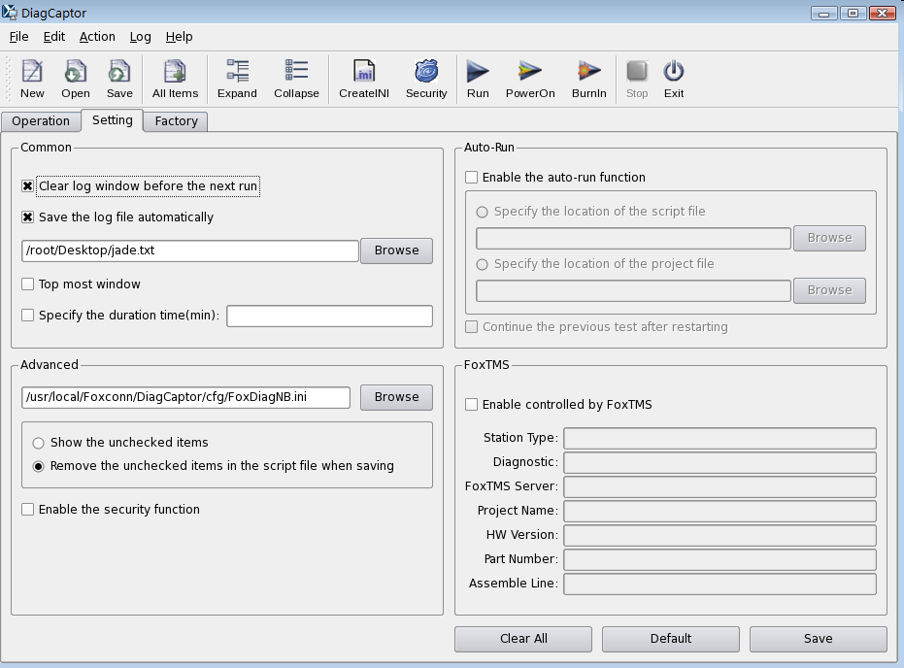
GUI mode (2 - Setting )

Slide 12
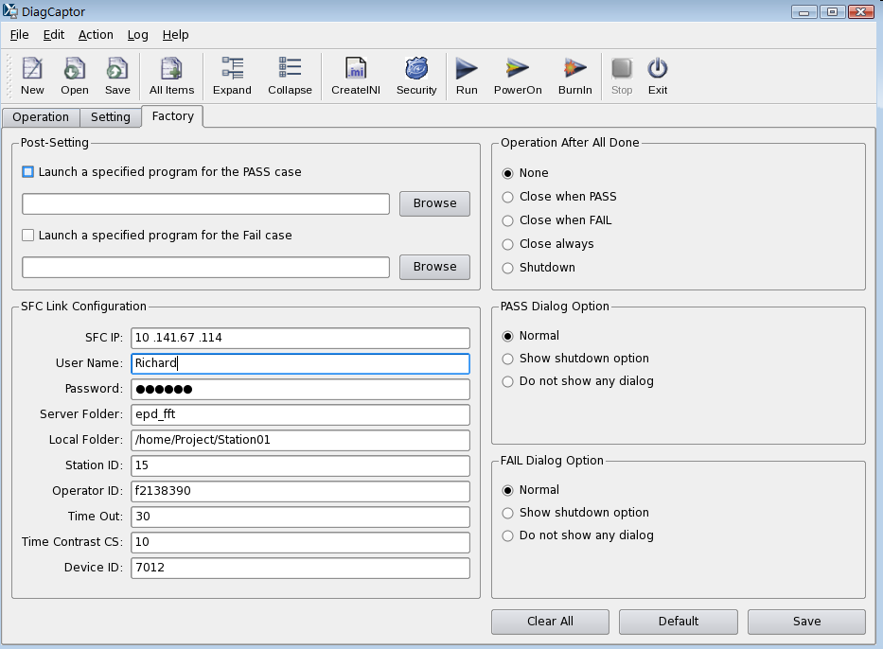
GUI mode (3 - Factory )

Slide 13
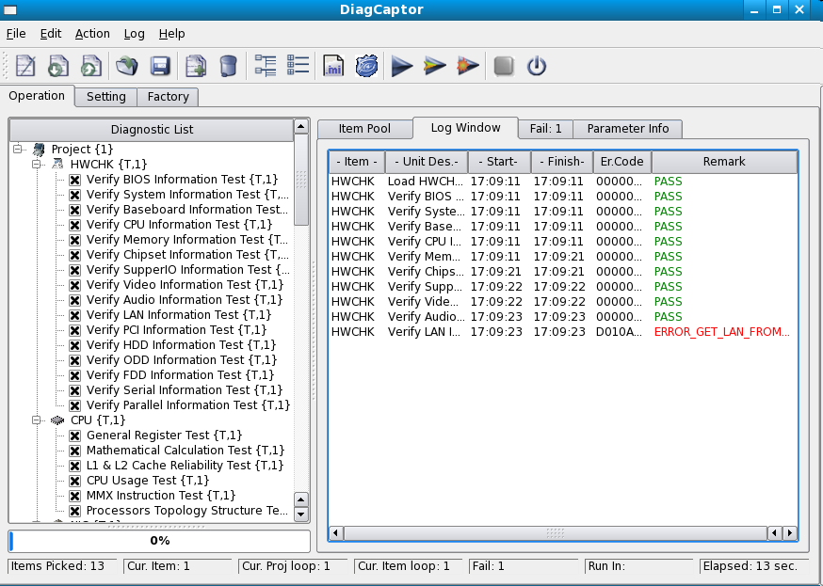
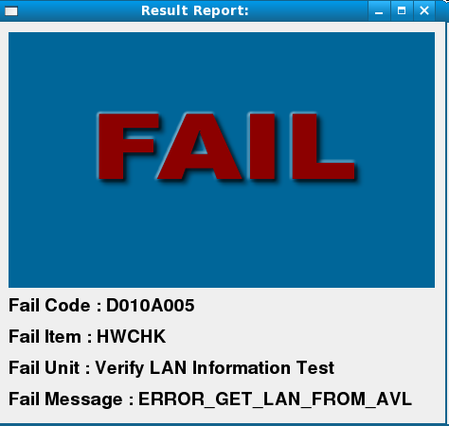

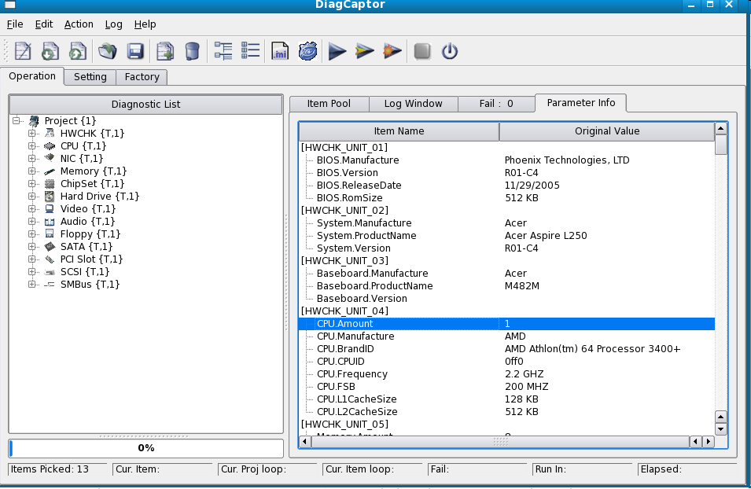

GUI mode (4 – Test report )

Slide 14
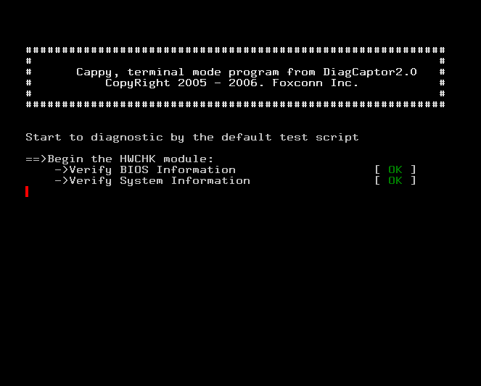
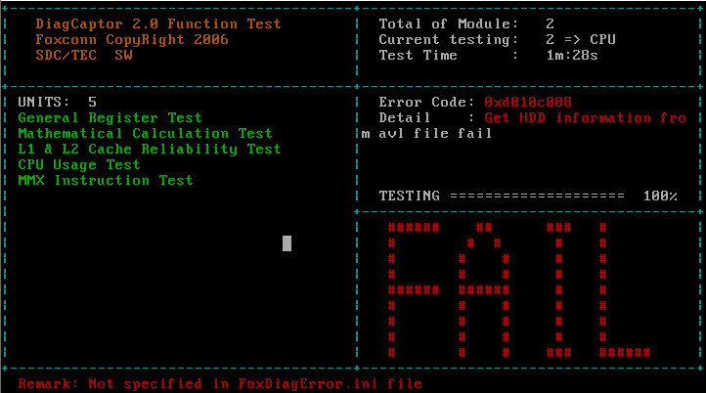
Terminal mode (Cappy)

Slide 15
Command Line Interface
CLI (a part of DiagCaptor2.2)
  The command line interface is an enhanced feature of DiagCaptor,
  and every module can be execute in the Linux terminal mode
User Interface
  # command [option]
  option can be [-h] [-l] [-c] [-d] [-a] … [-e value]

Slide 16
CLI Test Coverage
1 | HWCHK | 2 | CPU | 3 | Memory | 4 | Hard Drive
5 | Chipset | 6 | PCISlot | 7 | SMBus | 8 | NIC
9 | CMOS | 10 | Super IO | 11 | Audio | 12 | Serial Port
13 | Floppy | 14 | SATA | 15 | SCSI | 16 | SAS
17 | USB | 18 | LED | 19 | Buzzer | 20 | Parallel Port
21 | 1394 | 22 | PS2KB&MS | 23 | Optical Device | 24 | BMC
Test Module | Test unit
24 | 197

Slide 17
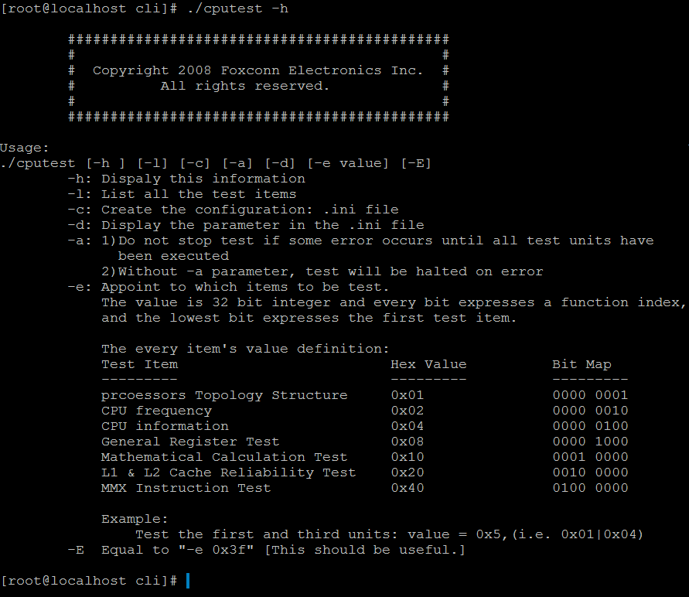
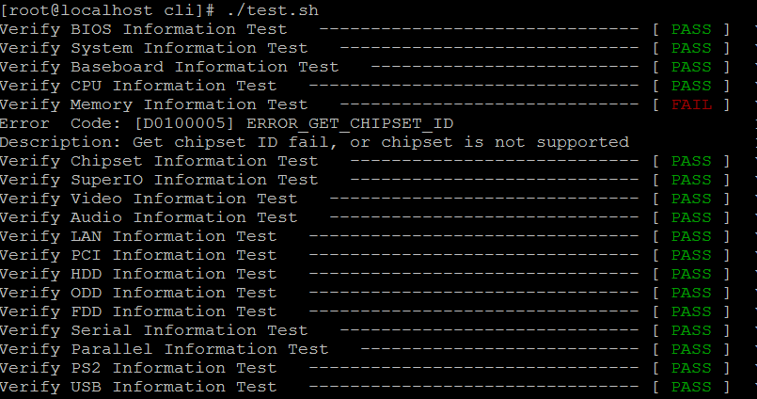
CLI testing
Option Illustration
# ./test.sh

Slide 18
Manufacturing Test Flow
Start
Load BIOS default
Verify the
MacAddress
FAIL
PASS
Boot to Linux
DiagCaptor:
Begin->…(Ex. HWCHK->CPU
->ChipSet->PCI->Memory)->
END
Input PPID/SN
DiagCaptor Test Pass
Login Fail
Contact with IT
End
Link SFC OK ?
FAIL
N
PASS
Display Error
Report to SFC
By .ccc File
Shutdown
Y
Time Check
Time Synchronization
FAIL
PASS
Transfer Test Result
to SFC by .CCC file
Can’t Create
File, Contact
with IT
End
Report to SFC,
Create Test Request
File(.xxx)
N
End
Shutdown
Y

Slide 19
Thank You!

